Slide 1

Project – 6 Rossmann Pharmaceuticals Sales Forecasting
NextHikes It Solutions
Presented by: khushnaz
Submitted deadline : 25/06/2025

Slide 2

Objective of the project
Tech stack: Python, pandas, skit-learn, TensorFlow, Streamlet Modules Covered: EDA, ML Model, LSTM, Time Series, Deployments .Predict the daily sales of Pharmaceutical stores. Use time Series and machine learning techniques. Deploy a user- friendly dashboard for predictions. I am source by geek for geek
vidhyaAnalytical
wshcool3

Slide 3
Dataset Overviews
Train : Historical sales data for example ( features : date, promo, holidays, etc.)
Test: Future dates where sales need to be predicted.
Store: Store-specific attributes.
Merged & cleaned data : train_data_merged_clean.csv & tets_data_merged_clean.csv

Slide 4
1. EDA(Exploratory Data Analysis)
1. First a fold load tha dataset by store train and test and clean missing values then merged the dataset by 2 set train_data_merged and tets_data_merged
2. Missing values checking again merged after and outliers.
3. Visualization sales trends, by holidays distribution trend and train seasonality, and impact of promotions.,correlation between sales , assortments effect opening reopeing time , competion distance ,, etc
4. Feature extraction from Date: Month, Day Week etc,

Slide 5
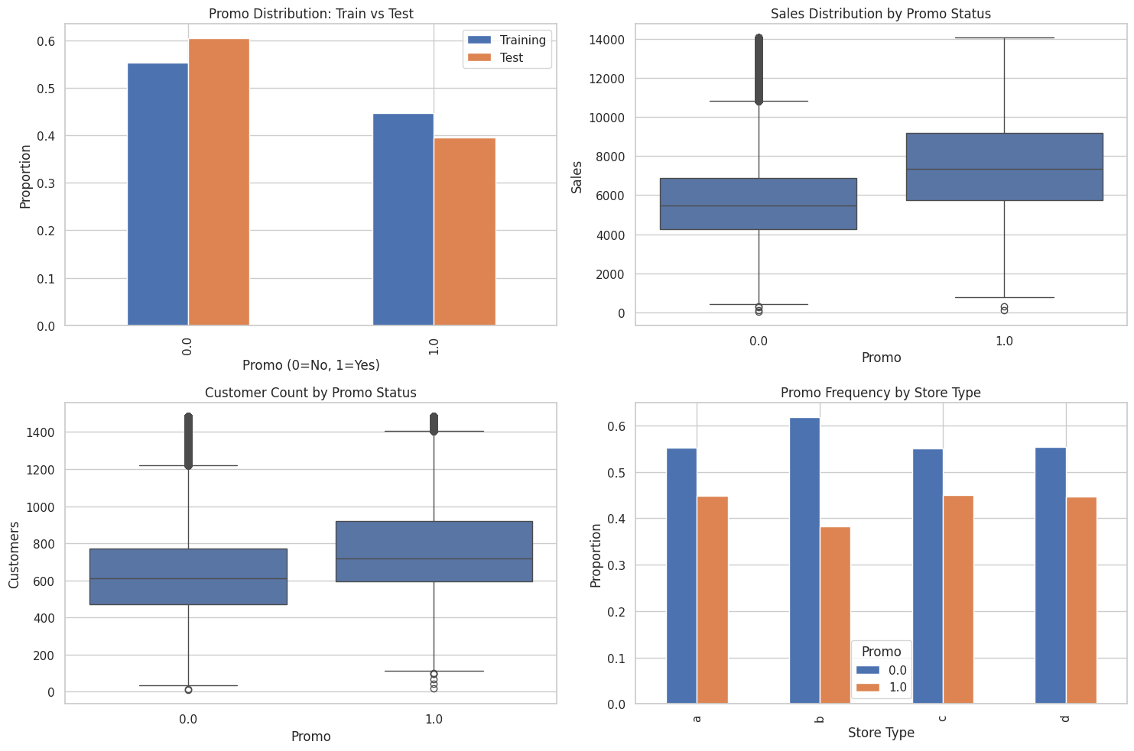
Features key for EDA for distribution

Slide 6
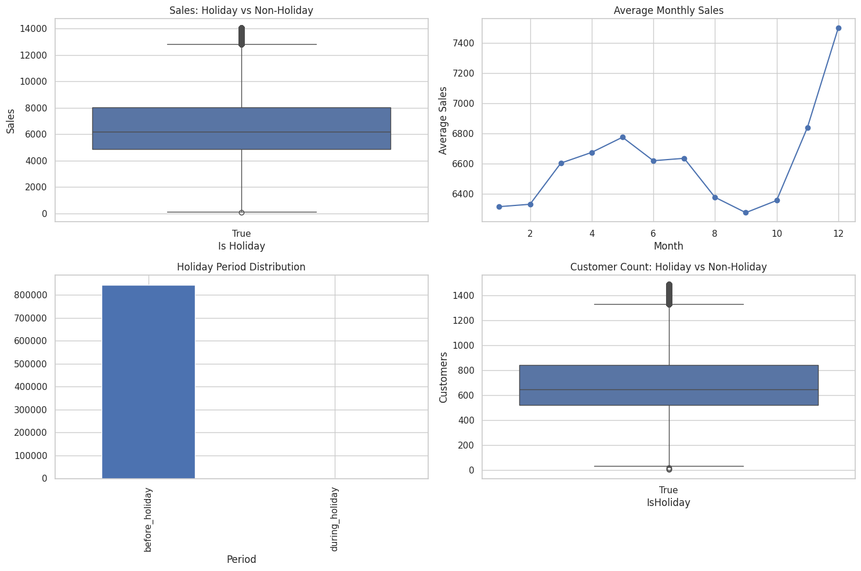
Features key for holidays

Slide 7
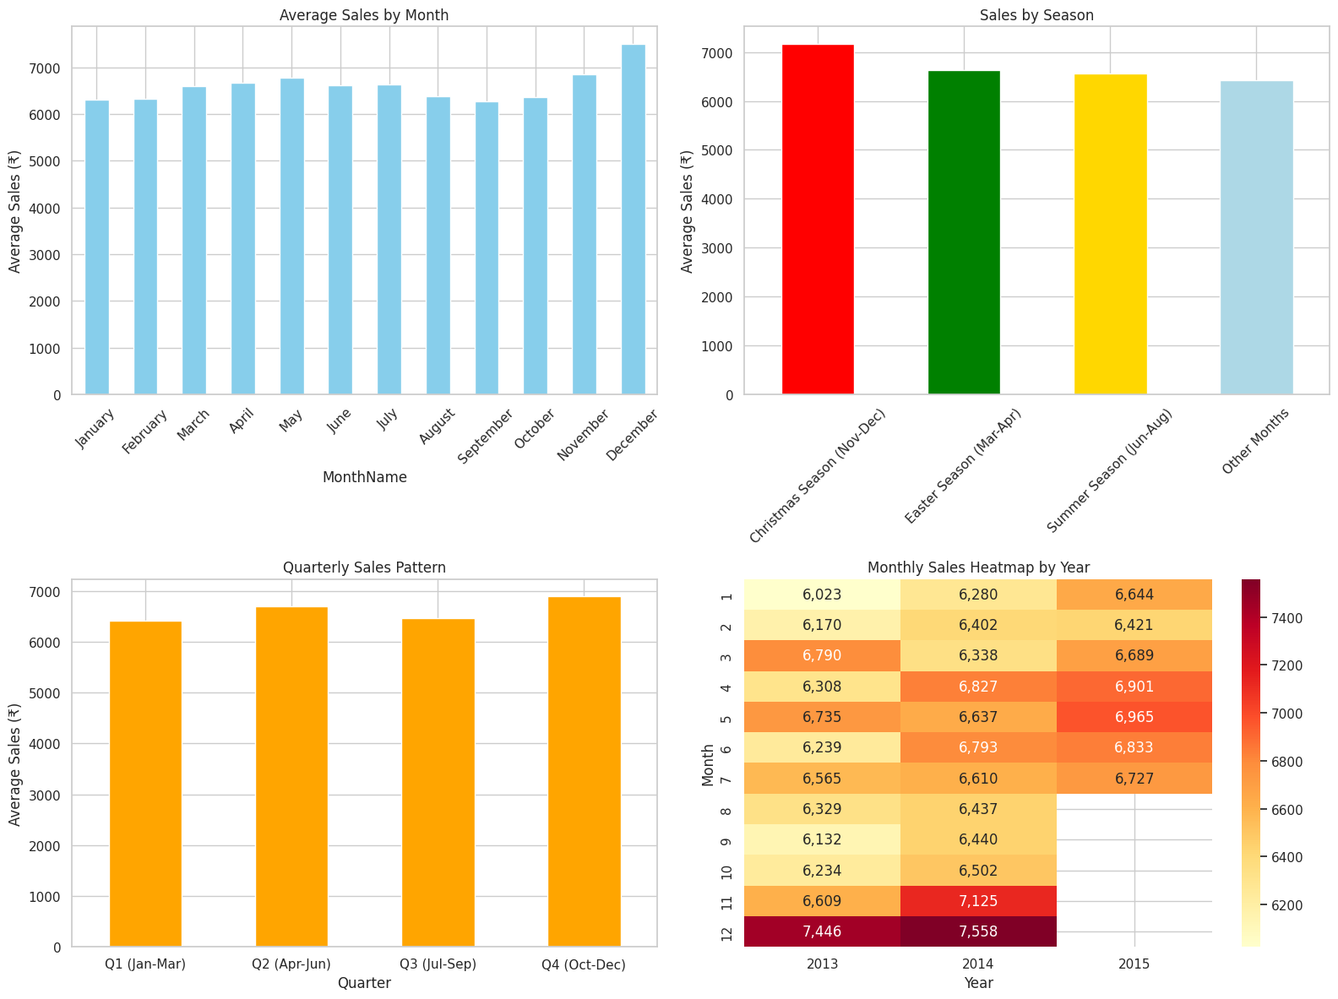
Features key seanolity

Slide 8
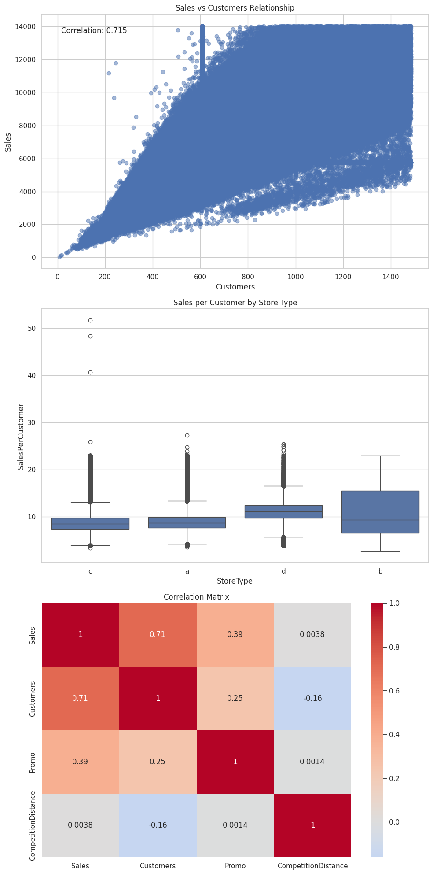
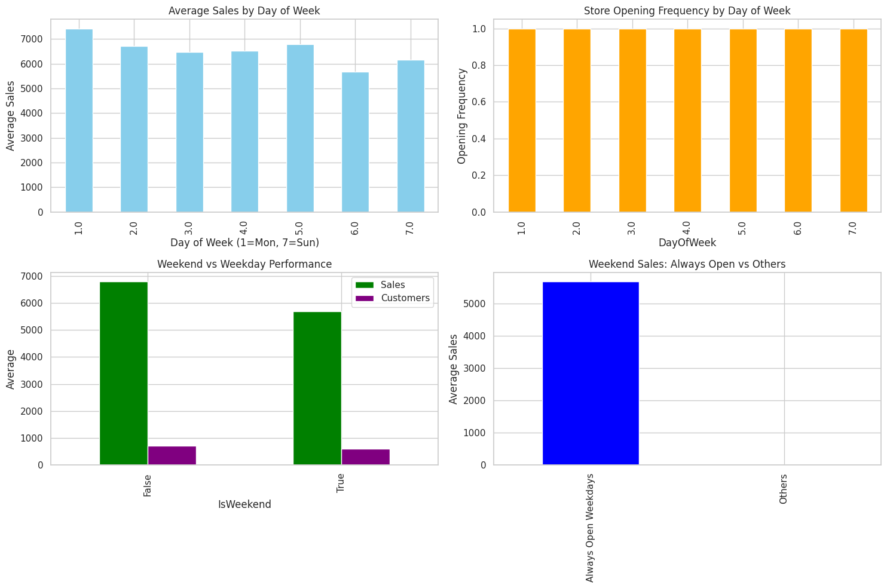
Key feature frequency & correlation

Slide 9
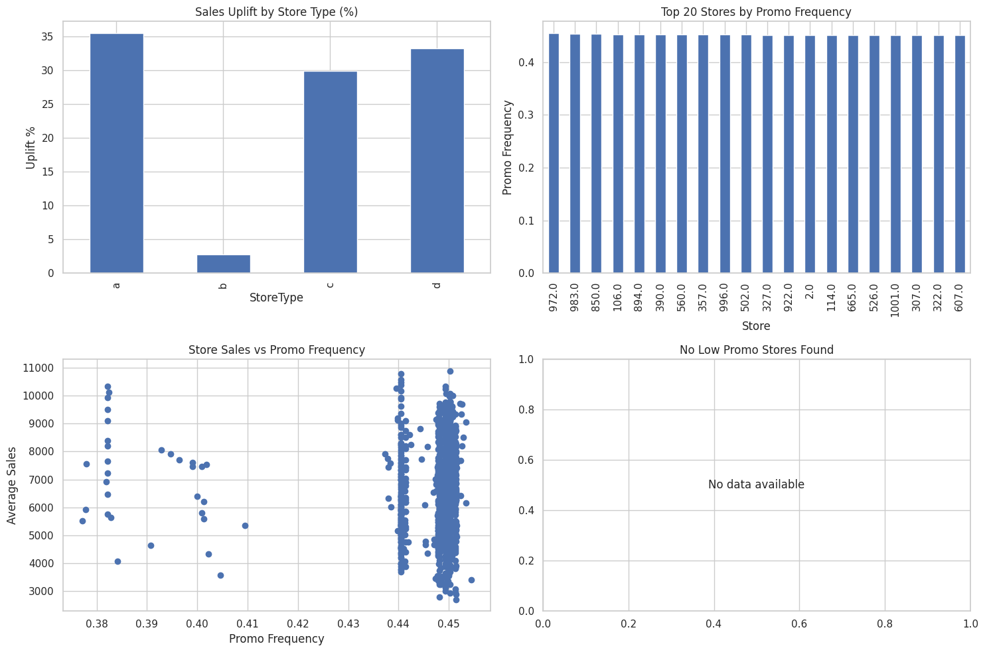
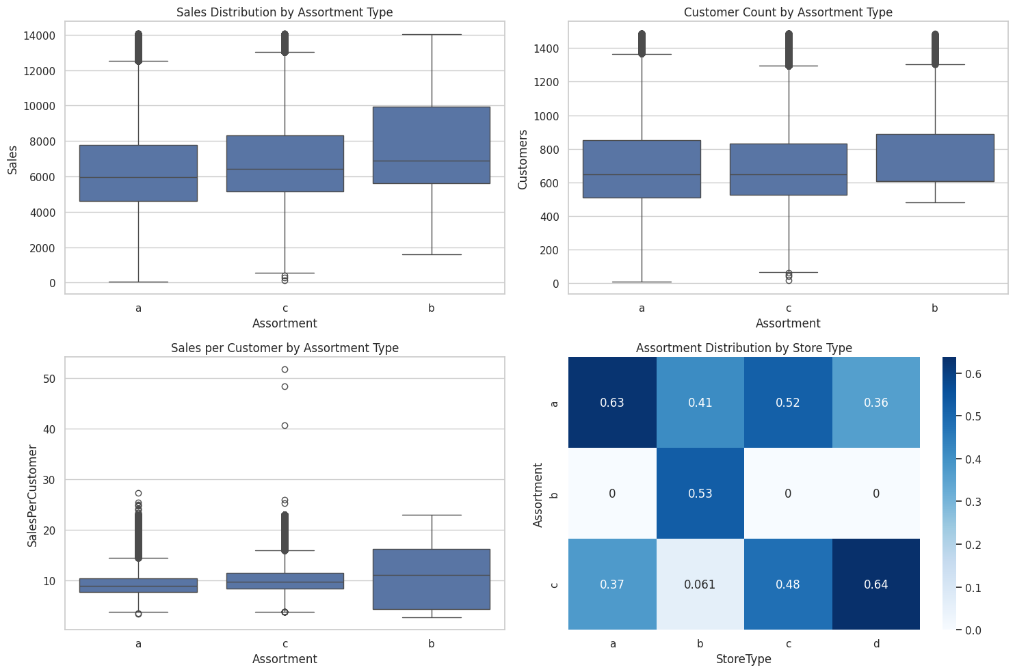
Key Assortments & Analysis

Slide 10
Features Engineering
Extract Time – base features example: Day, month, year, weekofyear, Ismonthend, ismonthmis, ismonthstart, etc
Created flag isholiday, ispromo, isweekend
Removed unneeded column

Slide 11

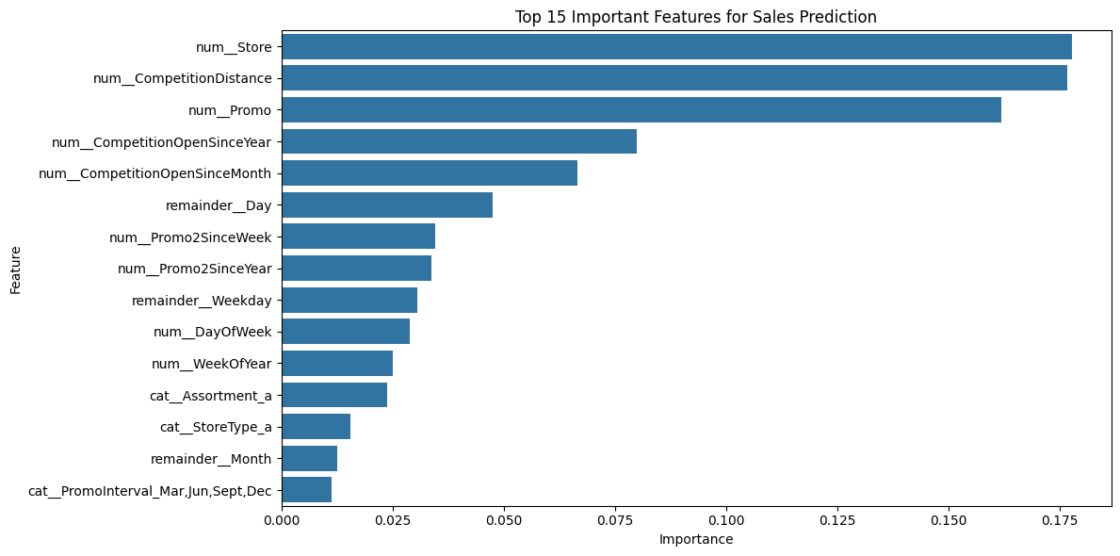
2. Machine learning
Use machine leaning now cleaned data load and used RandomForestRegressor on numerical features.
Tranained on train_data_merged_clean.csv
Preprocessed with Standscaler
And sample submission macting by predicted data after
Loss function use after prediction analysis
And serialize model using by ml flow model.pkl, feature_list.pkl and scaler.pkl adnas saved it model.

Slide 12
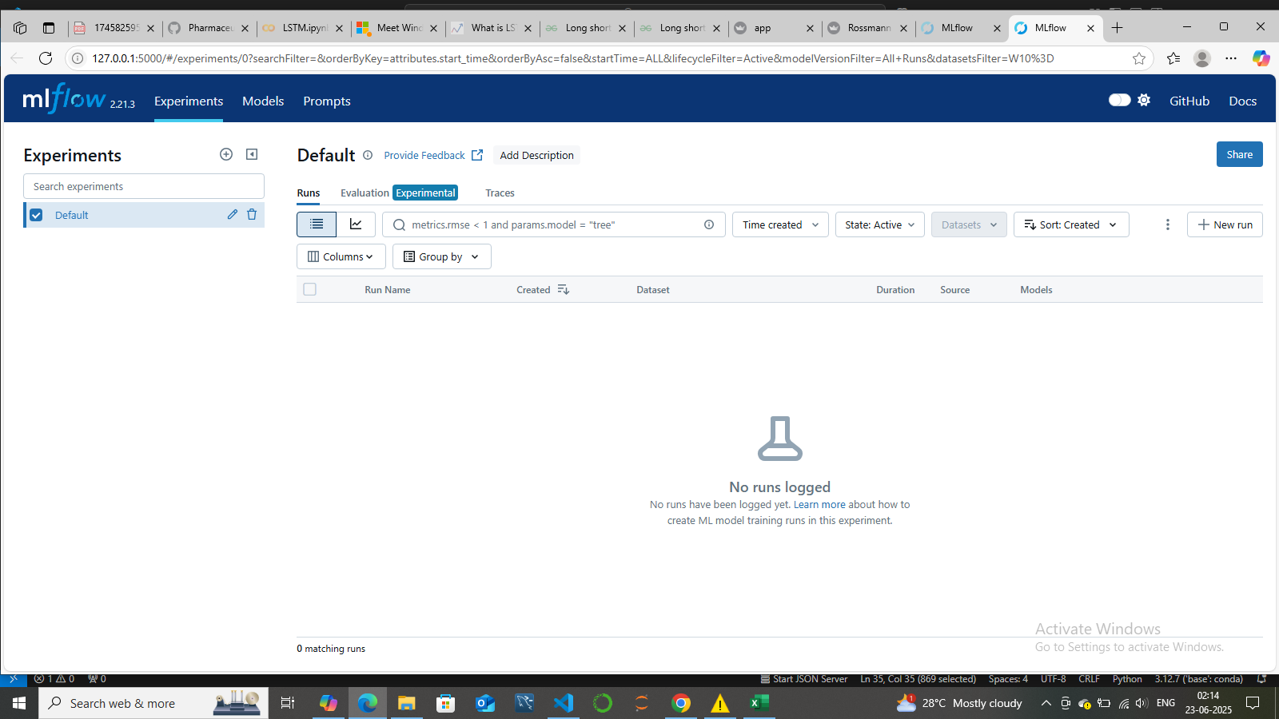
Ml flow

Slide 13
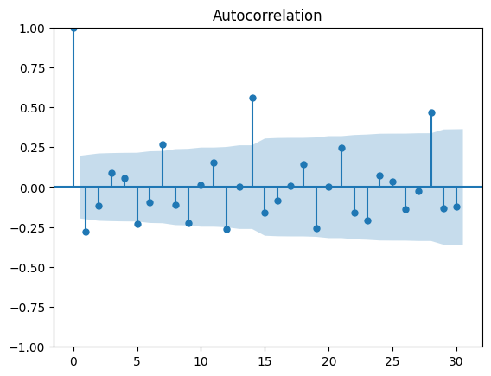

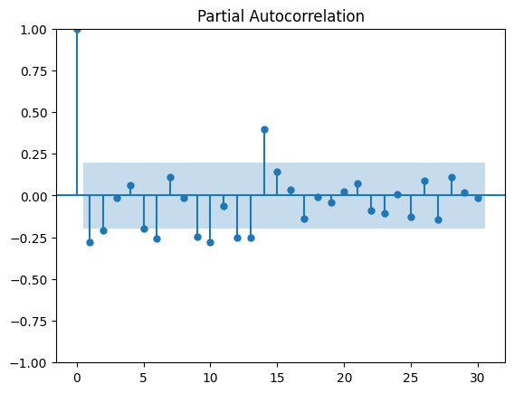
Time series
Times series by recurrent nural network part of time series by using
We used time series analysis to understand the trends and patterns in summary-level (aggregated) data. This involved analyzing values such as total sales, average temperature, or customer counts recorded at regular time intervals.
Objectives:
To track changes over time
To identify trends and seasonal patterns
To model the data for future forecasting
Example: “We analyzed the monthly sales data for the past 12 months, where total sales were recorded for each month
.”
Autocorrection and partinal

Slide 14
Deep learning LSTM
Used keras tensorflow for lstm for sequential prediction per store.
Trianed on cleaned store-wise daily sales
Model save as lstm_model.h5

Slide 15
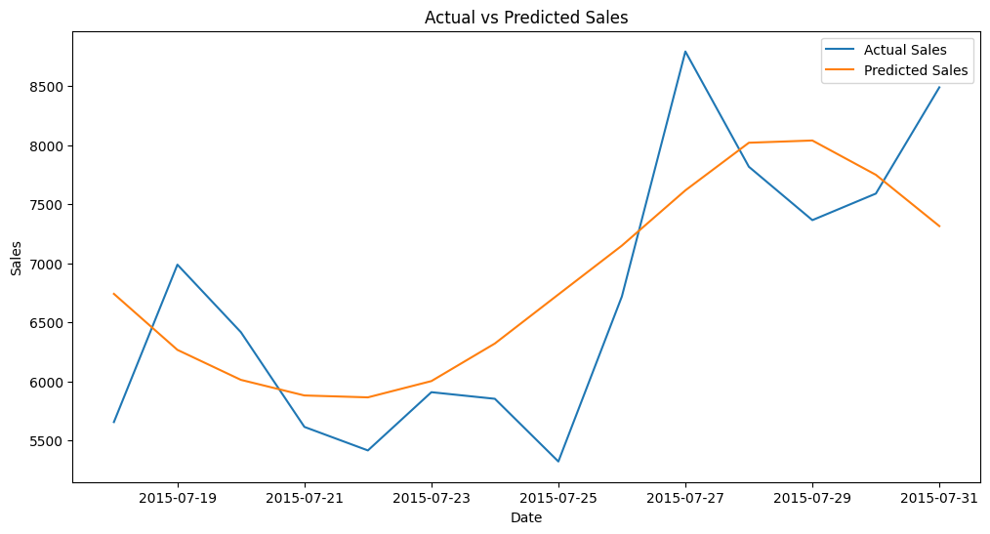
Lstm actual vs predictes dales

Slide 16
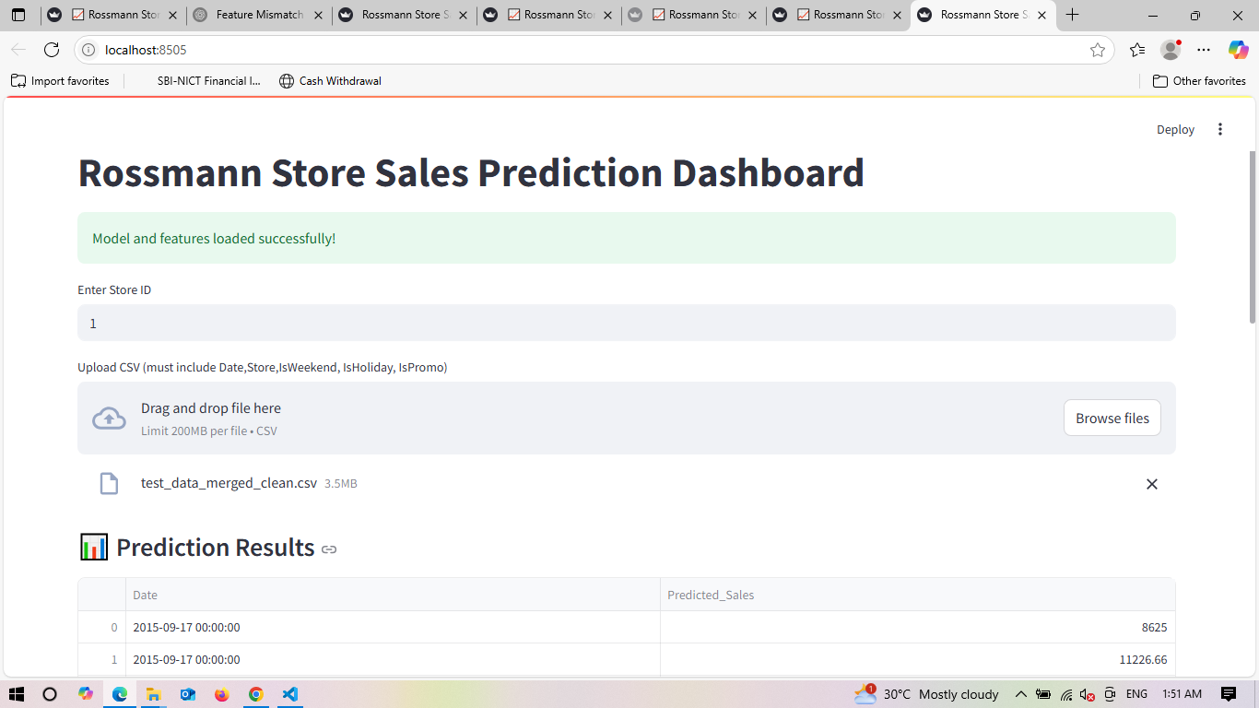
Streamlit dashboard
Uploaded cleaned data test csv(test_data_merged_clean.csv)
Allows choice ml and lstm but I am allows ml model
Outputs show here

Slide 17
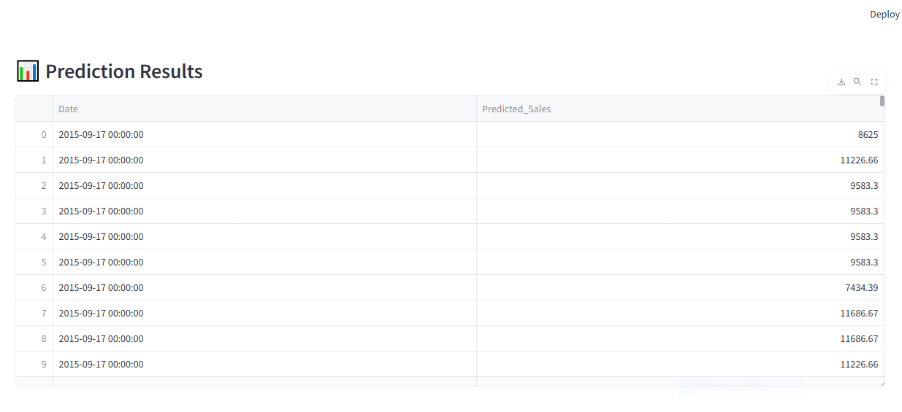
Predicted results

Slide 18
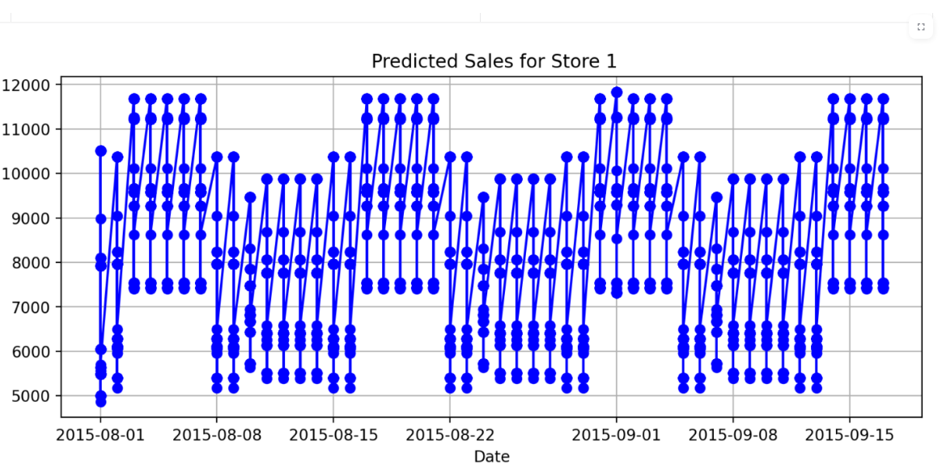
Sales forecast chart
Notes:
Now downloaded prediction csv files

Slide 19
Error handling $ feature matching
Ensured test data matches feature columns
Auto fills missing values with 0
Extra columns are ignored for robust prediction.
Conclusion: delivered accurate sales prediction using ml and dl
Successfully built an interactive predication dashboard.
Suitable for real-world deployments in pharmaceutical retail forecasting.

Slide 20

Thank you

